Slide 1

Classes, Interfaces, Arrays
Author: Radu Baroncea

Slide 2
What we will study ?
Classes
Inner Classes
Method-Local Inner Classes
Anonymous Inner Classes
Static Nested Classes
Interfaces
Enums
Arrays

Slide 3
Classes
Class – is a blueprint or prototype from which objects are created. It models the state and behavior of a real-world objects that we find in everyday life.
A class can contain any of the following variable types:
Local variables – variables defined inside methods, constructors, or blocks. The variable will be declared and initialized within the method and will be destroyed when the method has completed
Instance variables – variables within a class but outside any method. Instance variables can be accessed from inside any non-static method, constructor or blocks of that particular class
Class variables – variables declared in a class, outside any method, with the static keyword
A class can have any number of methods

Slide 4
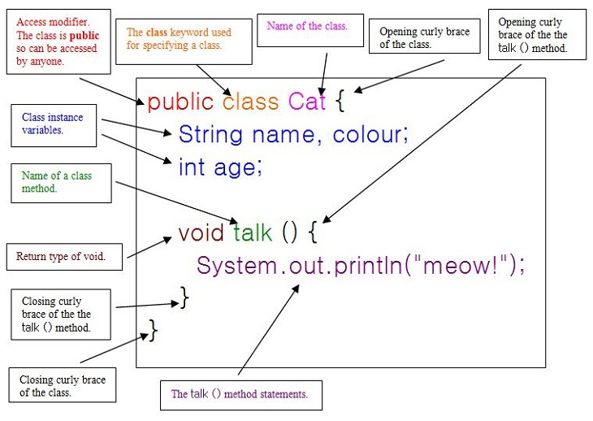

Slide 5
Inner Classes
A “regular” inner class is declared inside the curly braces of another class, but outside any method or other code block
An inner class is a full-fledged member of the enclosing (outer) class, so it can be marked with an access modifier as well as the abstract or final modifiers.
An inner class instance shares a special relationship with an instance of the enclosing class. This relationship gives the inner class access to all of the outer class’ members, including those marked private.
To instantiate an inner class, you must have a reference to an instance of the outer class
From code within the enclosing class, you can instantiate the inner class using only the name of the inner class
MyInner mi = new MyInner();

Slide 6
From code outside the enclosing class’ instance methods, you can instantiate the inner class only by using both the inner and outer class names, and a reference to the outer class
MyOuter mo = new MyOuter();
MyOuter.MyInner inner = mo.new MyInner();
From code within the inner class, the keyword this holds a reference to the inner class instance. To reference the outer this precede the keyword this with the outer class name: MyOuter.this

Slide 7
class MyOuter {
  private int x = 7;
  // inner class definition
  class MyInner {
    public void seeOuter() {
    System.out.println("Outer x is " + x);
    }
  } // close inner class definition
} // close outer class
public static void main(String[] args) {
  MyOuter mo = new MyOuter(); // gotta get an instance!
  MyOuter.MyInner inner = mo.new MyInner();
  inner.seeOuter();
}

Slide 8
Method-Local Inner Classes
A method-local inner class is defined within a method of the enclosing class
A method-local inner class cannot use variables declared within the method (including parameters) unless those variables are marked final
The only modifiers we can apply to a method-local inner class are abstract and final.
To use the method-local inner class we must make an instance of it somewhere within the method but below the inner class definition (or the compiler won’t be able to find the inner class)

Slide 9
class MyOuter2 {
  private String x = "Outer2";
  void doStuff() {
    class MyInner {
      public void seeOuter() {
      System.out.println("Outer x is " + x);
      } // close inner class method
    } // close inner class definition
    MyInner mi = new MyInner(); // This line must come
    // after the class
    mi.seeOuter();
  } // close outer class method doStuff()
} // close outer class

Slide 10
Anonymous Inner Classes
Anonymous inner classes have no name and their type must be either a subclass of the named type or an implementation of the named interface
An anonymous inner class is always created as part of a statement
Because of polymorphism, the only methods you can call on an anonymous inner class reference are those defined in the reference variable class (or interface)
An argument-defined inner class is declared, defined and automatically instantiated as part of a method invocation

Slide 11
class Popcorn {
  public void pop() {
  System.out.println("popcorn");
  }
}
class Food {
  Popcorn p = new Popcorn() {
    public void pop() {
    System.out.println("anonymous popcorn");
    }
  };
}

Slide 12
interface Cookable {
public void cook();
}
class Food {
  Cookable c = new Cookable() {
    public void cook() {
    System.out.println("anonymous cookable implementer");
    }
  };
}

Slide 13
Static Nested Classes
Static nested classes are inner classes marked with the static modifier
Because the nested class is static it does not share any special relationship with an instance of the outer class
Instantiating a static nested class requires using both the outer and nested class names:
BigOuter.Nested n = new BigOuter.Nested();
A static nested class cannot access non-static members of the outer class, since it does not have an implicit reference to any outer instance (in other words, the nested class instance does not get an outer this reference)

Slide 14
class BigOuter {
static class Nest {void go() { System.out.println("hi"); } }
}
class Broom {
  static class B2 {void goB2() { System.out.println("hi 2"); } }
  public static void main(String[] args) {
    BigOuter.Nest n = new BigOuter.Nest(); // both class names
    n.go();
    B2 b2 = new B2(); // access the enclosed class
    b2.goB2();
  }
}

Slide 15
Interfaces
Interfaces are contracts for what a class can do, but they say nothing about the way in which the class must do it
Interfaces can be implemented by any class, from any inheritance tree
An interface is like a 100-percent abstract class and is implicitly abstract whether you type the abstract modifier in the declaration or not
An interface can have only abstract methods, no concrete methods allowed
Interface methods are by default public and abstract - explicit declaration of these modifiers is optional
Interfaces can have constants, which are always implicitly public, static and final (which are also optional)

Slide 16
A legal nonabstract implementing class has the following properties
It provides concrete implementations for the interface’s methods
It must follow all legal override rules for the methods it implements
It must not declare any new checked exceptions for an implementation method
It must not declare any checked exceptions that are broader than the exceptions declared in the interface method
It may declare runtime exceptions on any interface method implementation regardless of the interface declaration
It must maintain the exact signature
A class implementing an interface can itself be abstract
An abstract implementing class does not have to implement the interface methods (but the first concrete subclass must)
A class can extend only one class, but it can implement many interfaces
Interfaces can extend one or more other interfaces

Slide 17
Enums
An enum specifies a list of constant values assigned to a type
An enum is not a String or an int; an enum constant’s type is the enum type. For example, SUMMER and FALL are of the enum type Season
Enums can contain constructors, methods, variables and constant class bodies
Enum constructors can never be invoked directly in code. They are always called automatically when an enum is initialized
An example can be found here: http://docs.oracle.com/javase/tutorial/java/javaOO/enum.html

Slide 18
Arrays
In Java, arrays are objects created dynamically and can be assigned to variables of type Object
Arrays can hold primitives or objects
It is never legal to include the size of an array in the declaration
We must include the size of an array when we construct it (using new)
Elements in an array of objects are not automatically created, although primitive array elements are given default values
All elements inside an array are of the same type
If an array has n elements, we say that n is the array’s length (which can be obtained by attribute length) and the elements can be accessed using indices from 0 to n-1
An example can be found here: http://docs.oracle.com/javase/tutorial/java/nutsandbolts/arrays.html

